Slide 1
Andrew Buxa
Motif Finding using randomized algorithms

Slide 2
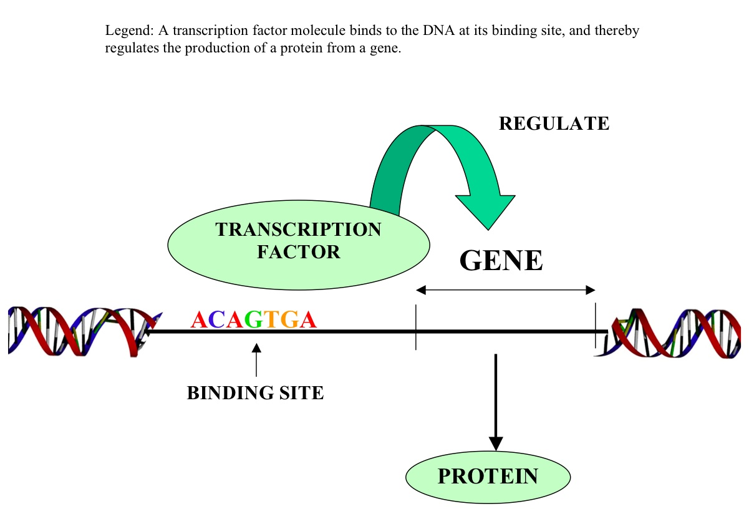
Introduction
What is a motif?
A short DNA interval that a transcription factor binds to in order to regulate a gene.
Example of a motif in real life:
Plants need to change gene expression of over a thousand genes (photosynthesis, flowering, frost resistance, etc) switching from day to night and vice-versa. Example: A sunflower will always follow the sun.
Example of a motif in a nucleotide sequence:
ttACCTtaac

Slide 3
Randomized Motif Search
RandomizedMotifSearch(Dna, k, iterations)
Randomly select a position in each sequence from 0 to length of sequence for each sequence.
Add the position + k to a list called bestMotifs
While i <= iterations:
Randomly select a position in each sequence from 1 to length of sequence for each sequence
Add the position + k to a list called motifs
Calculate the score for both of the lists.
Done by calculating the hamming distance between the consensus sequence of the list of motifs and the individual sequence itself.
Check if the score for the motifs list is less than the bestMotifs list.
If so, set motifs equal to bestMotifs and continue in the loop
Else, return bestMotifs.

Slide 4
Overview of Randomized Search
Designed so that subsequent steps have a good chance of leading us towards implanted motifs (although it is not certain).
Since one run of Randomized Search may yield a poor set of motifs, it’s good to have it run thousands of times.
This way of finding the score for each set of motifs isn’t the best. It stands a chance of being inaccurate.
t | t | a | c | c | t | t | a | a | c
g | a | t | a | t | c | t | g | t | c
a | c | g | g | c | g | t | t | c | g
c | c | c | t | a | a | a | g | a | g
c | g | t | c | a | g | a | g | g | t
t | t | a | c | c | t | t | a | a | c
g | a | t | a | t | c | t | g | t | c
a | c | g | g | c | g | t | t | c | g
c | c | c | t | a | a | a | g | a | g
c | g | t | c | a | g | a | g | g | t
Iteration 1
Iteration 2

Slide 5
Gibbs Sampling
Gibbs Sampler(Dna, k, iterations):
Calculate the nucleotide frequencies of the sequences
While (i < iterations):
Generate a random start location in each sequence of Dna
Get motifs given sequences, start locations and k in a list called motifList
While j <= iterations:
Repeat first 2 steps but save it into a tempMotifList
Construct profile for tempMotifList (tmProfile)
Apply the profile(find the frequencies of each nucleotide in each sequence) of tempMotifList and call it tempMotifProfile.
Get a random index from the probabilities (normalized numbers and randomly returns the index of selected number)
Construct another profile of the original motifList (mlProfile)
if score of tmProfile > mlProfile
set bestMotifs to tempMotifList
return bestMotifs

Slide 6
Overview of Gibbs Sampling
Selects a profile randomly generated k-mer at each step.
Makes slight changes to the list of motifs if a better one is randomly found.

Slide 7
Differences between Randomized Search and Gibbs Sampling
Gibbs Sampling starts with randomly chosen k-mers in each of the t DNA sequences, but it makes a random rather than deterministic choice each iteration.
Gibbs Sampling randomly selects an integer i and t and then randomly changes a single k-mer Motif_{i}
t | t | a | c | c | t | t | a | a | c
g | a | t | a | t | c | t | g | t | c
a | c | g | g | c | g | t | t | c | g
c | c | c | t | a | a | a | g | a | g
c | g | t | c | a | g | a | g | g | t
t | t | a | c | c | t | t | a | a | c
g | a | t | a | t | c | t | g | t | c
a | c | g | g | c | g | t | t | c | g
c | c | c | t | a | a | a | g | a | g
c | g | t | c | a | g | a | g | g | t
Changes one k-mer in one step

Slide 8
MEME (Multiple EM for Motif Elicitation)
MEME(dataset,w,nsites,passes)
while count <= passes:
calculate nucleotide frequencies for the dataset
for each sequence in the list
split each sequence into subsequences of size w (Ex: dataset of AGC, sub sequences would be AG, GC if the w size was 2)
construct the profile of each subsequence, then add the profile, sequence and position of the sequence into a list.
Sort the list based off the score in ascending order.
Calculate the profile of the last nsites of the worst scoring motifs
Build a profile using the last nsites amount of matches
Run randomized motif search (with one change to allow multiple or no matches per sequence up to nsites) to be found.
Then remove those motifs from the dataset, which you have their index and position.
Repeat these steps.

Slide 9
Overview of MEME
Speed: O(n²) where n is the size of the dataset in characters
Can discover multiple binding site motifs.
“Erasing” one motif is necessary to find another.
The expected number of motif appearances(nsites) is not critical.
Greedily selects best starting points based off the score of the highest found motif.

Slide 10
Differences between MEME and Gibbs Sampling
MEME can select multiple motifs in each sequence rather than strictly one per sequence.
MEME stores each score for the motifs and their index/position.

Slide 11
Results/ Expected Results
TCCGGTCGCATCTCCCTGGAAATCCTGCGGCGTCTGTTCCGCTGCAAGATTTCCTCAAAAGCACTTCGGAAGGAATGTGCAGATCTGCACGTCGGCAAAGCCGACACTTTGGAGGATGATCCCGCCGC
CGTAATCTCCGCATGAACAGGTCATGCGAACAGAAATCATCTCACGGTGCGTTTGCCTACGTGCAGATTTGCACCTCAGGTGATTCTACCGAGTCGGTGTTCCAAGGCGCGAAA
TGCGAGCGGGTGAGGCCGACCAGACGCCGACAAGGTTGTGCAGATCTGCACTTGGTGCCACGTCGCACAGAAGAAGGGAATCGGTCTAACTCACAGATAGCATT
CAAGTCGCGTTGATTTCTTCTTCGAAAGCATAGGCCTTGAGGTATTTTGTGCCTTGCATCGAGGTGGGCATGTGAAGATTTGCACCGTCGTTCTGTCGAT
k size of 6
Randomized Motif Search
Result:
Execution time: .09 seconds given 500 iterations
['GGAAGG', 'GTTTGC', 'GCGAGC', 'GTGGGC']
Gibbs Sampling
Result:
Execution time: 11.4 minutes given 500 iterations.
['TTCGGA', 'TCTACC', 'AAGGTT', 'GGGCAT']
MEME
Result (Estimated):
Execution time: O(n²)
['TTCGGA', 'TCTACC', 'AAGGTT', 'GGGCAT‘, 'GGAAGG', 'GTTTGC', 'GCGAGC', 'GTGGGC']

Slide 12
Why I chose this project

Slide 13
Difficulties with the project

Slide 14
Possible Enhancements to the programs
Randomized Motif Search:
Implement entropy as a way of scoring.
Gibbs Sampling:
Improve the speed.
MEME:
Make it work……..

Slide 15
Sources/Resources
Compeau, Phillip, and Pavel Pevzner. Bioinformatics Algorithms: An Active Learning Approach. La Jolla, CA: Active Learning, 2015. Print.
https://www.ncbi.nlm.nih.gov/pmc/articles/PMC1538909/
Brad Goodner /Louis Oliphant – Motif Finding and Gibbs Sampler.

